Slide 1



Adaptive Control System for HVAC Optimization Using LLM and Fuzzy Logic
Project Supervisor : Dr. D. H. S. Maithripala
Yapa W.S.P.Y.J.C.
E/20/452
Athukorala L.A.K.S.
E/20/028
Wijekoon W.M.M.K.
E/20/442
Department of Mechanical Engineering
University of Peradeniya

Slide 2
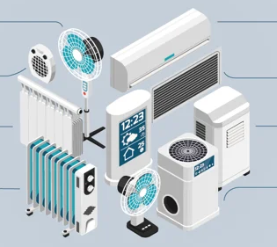
Aim
To design an adaptive HVAC control system that enhances energy efficiency and indoor comfort by integrating disturbance prediction with dynamic fuzzy logic rules generated using a Large Language Model (LLM).
Department of Mechanical Engineering
University of Peradeniya
Notes:
“Our aim is to create an intelligent HVAC control system that dynamically adapts to environmental and occupancy changes. We a Large Language Model to generate fuzzy logic rules in real-time. This eliminates the need for manually crafted rules and allows for more flexible, context-aware HVAC control.”

Slide 3
Objectives
To Analyze limitations of static HVAC systems in high-demand environments (e.g., data centers).
To Develop an LLM-enhanced fuzzy logic controller to generate adaptive HVAC rules.
To Validate system performance through simulations and controlled experiments, evaluating key metrics such as:
Energy consumption
Thermal stability
Response time to environmental changes
To Compare performance against traditional HVAC systems under varying environmental conditions.
Department of Mechanical Engineering
University of Peradeniya

Slide 4
Intended Learning Outcomes
Apply Large Language Models (LLMs) to generate and refine fuzzy logic rules for control applications.
Design and simulate an intelligent control system using appropriate computational tools (e.g., MATLAB, Python).
Evaluate the performance of HVAC control systems based on energy efficiency, thermal stability, and adaptability.
Improve project planning, teamwork, and technical reporting through hands-on implementation and collaboration.
Department of Mechanical Engineering
University of Peradeniya

Slide 5
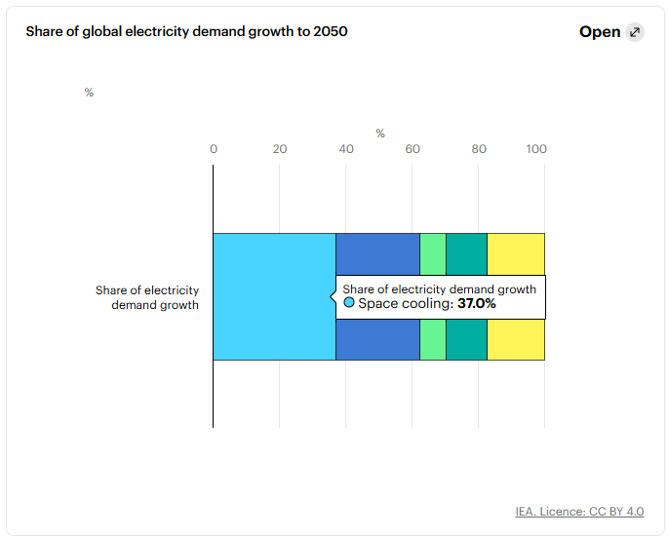
Introduction
Problem :
Traditional HVAC systems in data centers waste up to 38% of energy due to static rules and poor adaptability to sudden real-time changes .
Reference :
Ni, J. and Bai, X. (2017). A review of air conditioning energy performance in data centers. Renewable and Sustainable Energy Reviews, 67, pp.625–640. doi:https://doi.org/10.1016/j.rser.2016.09.050.
IEA (2018). The Future of Cooling – Analysis - IEA. [online] IEA. Available at: https://www.iea.org/reports/the-future-of-cooling
Department of Mechanical Engineering
University of Peradeniya

Slide 6
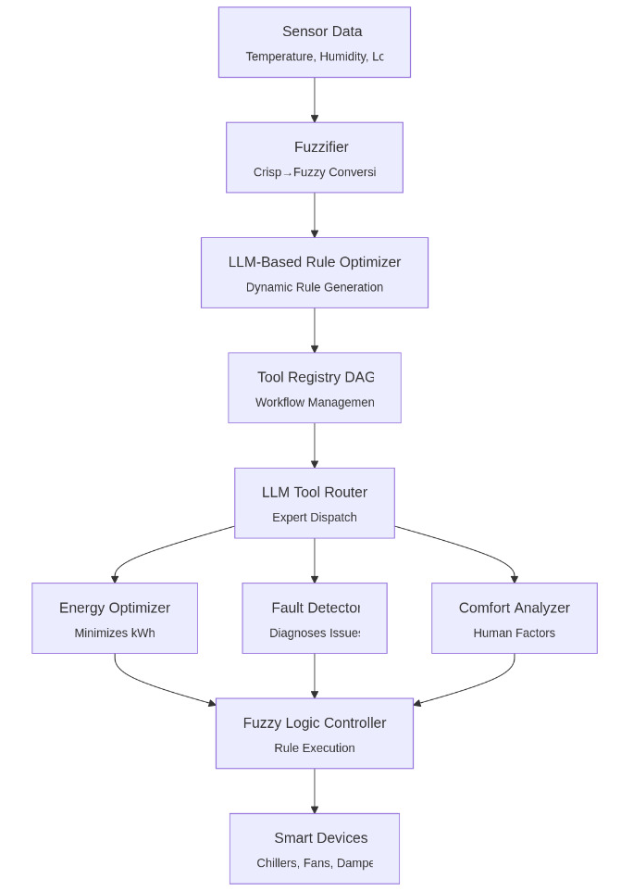
Introduction
Solution :
We use a Large Language Model to generate fuzzy control rules dynamically, enabling real-time adaptive HVAC response to disturbances.
Reference : IEA (2018). The Future of Cooling – Analysis - IEA. [online] IEA. Available at: https://www.iea.org/reports/the-future-of-cooling
Department of Mechanical Engineering
University of Peradeniya

Slide 7
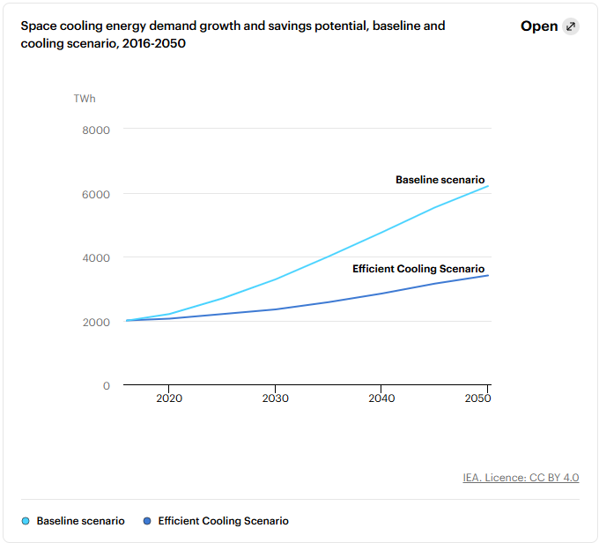
Introduction
Impact :
This approach can reduce energy consumption, improve performance, improve thermal comfort, and extend equipment life span.
Reference : IEA (2018). The Future of Cooling – Analysis - IEA. [online] IEA. Available at: https://www.iea.org/reports/the-future-of-cooling
Department of Mechanical Engineering
University of Peradeniya

Slide 8
Methodology
Design Phase
Collect data from a small-scale data center
Use a Large Language Model (LLM) to generate and refine fuzzy logic rules based on patterns in temperature, load, etc.
Implementation Phase
Simulate using MATLAB or Python
Integrate LLM-generated rules into a fuzzy logic controller for real-time adaptive control.
Testing Phase
Simulate different thermal conditions using historical data.
Test system performance using a test bench
Evaluation Phase
Evaluate system performance based on energy efficiency, thermal stability, and responsiveness.
Compare results with conventional HVAC controls.
Department of Mechanical Engineering
University of Peradeniya

Slide 9



Software’s
Department of Mechanical Engineering
University of Peradeniya

Slide 10
Timeline
No | Task | Week
 |  | 01 | 02 | 03 | 04 | 05 | 06 | 07 | 08 | 09 | 10 | 11 | 12 | 13
1 | Brainstorming, Supervisor Meeting, and Finalizing Project Scope
2 | Literature Review
3 | Data Collection and System Design
4 | LLM Integration and Initial Fuzzy Logic Setup
5 | Refining System Design and Rule Tuning
6 | Preparing For Mid Evaluation
7 | Start Simulations and Initial Testing
8 | Refinements and System Testing
9 | Final Testing and Report Finalization
10 | Final Submission and Demonstration
Department of Mechanical Engineering
University of Peradeniya

Slide 11
References
Dev, P., Jain, S., Arora, P.K. and Kumar, H., 2021. Machine learning and its impact on control systems: A review. Materials Today: Proceedings, 47, pp.3744-3749.
Yang, Z., Ghahramani, A. and Becerik-Gerber, B. (2016). Building occupancy diversity and HVAC (heating, ventilation, and air conditioning) system energy efficiency. Energy, 109, pp.641–649. doi:https://doi.org/10.1016/j.energy.2016.04.099.
Ni, J. and Bai, X. (2017). A review of air conditioning energy performance in data centers. Renewable and Sustainable Energy Reviews, 67, pp.625–640. doi:https://doi.org/10.1016/j.rser.2016.09.050.
Adel Nadjaran Toosi and Rajkumar Buyya (2015). A Fuzzy Logic-Based Controller for Cost and Energy Efficient Load Balancing in Geo-distributed Data Centers. IEEE/ACM International Conference Utility and Cloud Computing. doi:https://doi.org/10.1109/ucc.2015.35.
Esrafilian-Najafabadi, M. and Haghighat, F., 2021. Occupancy-based HVAC control using deep learning algorithms for estimating online preconditioning time in residential buildings. Energy and Buildings, 252, p.111377.
Mendel, J.M. (2000). Uncertainty, fuzzy logic, and signal processing. Signal Processing, 80(6), pp.913–933. doi:https://doi.org/10.1016/s0165-1684(00)00011-6.
Office of Energy Efficiency & Renewable Energy (2024). Data Centers and Servers. [online] Energy.gov. Available at: https://www.energy.gov/eere/buildings/data-centers-and-servers.
IEA (2018). The Future of Cooling – Analysis - IEA. [online] IEA. Available at: https://www.iea.org/reports/the-future-of-cooling
Department of Mechanical Engineering
University of Peradeniya

Slide 12
Q&A
Department of Mechanical Engineering
University of Peradeniya

